Slide 1
Joseph: Just as chosen as Mary (as are you)

Slide 2
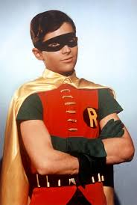

Slide 3
Points
It HAD to be Joseph – Family Lineage
It HAD to be Joseph – The faithful, obedient, loving husband and father
He was just as chosen as Mary
You are just as chosen as Mary and Joseph

Slide 4
Matthew 1: 1-16
The Genealogy of Jesus the Messiah
1 This is the genealogy^{[a]} of Jesus the Messiah^{[b]} the son of David, the son of Abraham: ² Abraham was the father of Isaac, Isaac the father of Jacob, Jacob the father of Judah and his brothers, ³ Judah the father of Perez and Zerah, whose mother was Tamar, Perez the father of Hezron, Hezron the father of Ram,⁴ Ram the father of Amminadab, Amminadab the father of Nahshon, Nahshon the father of Salmon, ⁵ Salmon the father of Boaz, whose mother was Rahab, Boaz the father of Obed, whose mother was Ruth, Obed the father of Jesse, ⁶ and Jesse the father of King David. David was the father of Solomon, whose mother had been Uriah’s wife, ⁷ Solomon the father of Rehoboam, Rehoboam the father of Abijah, Abijah the father of Asa, ⁸ Asa the father of Jehoshaphat, Jehoshaphat the father of Jehoram, Jehoram the father of Uzziah, ⁹ Uzziah the father of Jotham, Jotham the father of Ahaz, Ahaz the father of Hezekiah, ¹⁰ Hezekiah the father of Manasseh, Manasseh the father of Amon, Amon the father of Josiah, ¹¹ and Josiah the father of Jeconiah^{[c]} and his brothers at the time of the exile to Babylon. ¹² After the exile to Babylon:
Jeconiah was the father of Shealtiel, Shealtiel the father of Zerubbabel, ¹³ Zerubbabel the father of Abihud, Abihud the father of Eliakim, Eliakim the father of Azor, ¹⁴ Azor the father of Zadok, Zadok the father of Akim, Akim the father of Elihud, ¹⁵ Elihud the father of Eleazar, Eleazar the father of Matthan, Matthan the father of Jacob, ¹⁶ and Jacob the father of Joseph, the husband of Mary, and Mary was the mother of Jesus who is called the Messiah.

Slide 5
Isaiah 7: 13-14
¹³ Then Isaiah said, “Hear now, you house of David! Is it not enough to try the patience of humans? Will you try the patience of my God also? ¹⁴ Therefore the Lord himself will give you^{[c]} a sign: The virgin^{[d]} will conceive and give birth to a son, and^{[e]} will call him Immanuel.^{[f]}

Slide 6


Slide 7
It HAD to be Joseph
Descendent of David, as promised by the prophet Isaiah
Family lineage is passed from father to son

Slide 8
Matthew 1:18-19
Joseph Accepts Jesus as His Son
¹⁸ This is how the birth of Jesus the Messiah came about^{[d]}: His mother Mary was pledged to be married to Joseph, but before they came together, she was found to be pregnant through the Holy Spirit. ¹⁹ Because Joseph her husband was faithful to the law, and yet^{[e]} did not want to expose her to public disgrace, he had in mind to divorce her quietly.

Slide 9
Context of Betrothal
In ancient Jewish culture, betrothal was far more serious than a modern engagement; it was a legally binding contract considered the first stage of marriage. The only thing that remained was for the groom to bring the bride to his home for the wedding and consummation. During the betrothal period, the couple was expected to be sexually abstinent, and infidelity was considered adultery, a capital offense punishable by death (often stoning) under the law, though the penalty was often not carried out in the Roman era.
The Social Dilemma
When Mary was found to be with child, the community would have assumed the child was not Joseph's, which would bring immense shame not only on Mary but also on her family. She faced:
Public Scorn: She would have been an object of widespread public scorn and subject to suspicious glances and ridicule.
Rejection: She faced potential rejection from her family, peers, and her fiancé, Joseph.
Legal Danger: Joseph, being a "righteous man," initially planned to "put her away quietly" (divorce her privately) rather than publicly shame her or expose her to the full penalties of the law, which suggests the potential for severe punishment was real.
Lifetime Stigma: Had Joseph gone through with a divorce, Mary would likely have remained a single mother for life, treated with stigma, and her son would have been considered illegitimate, affecting his social standing and inheritance rights.
Ultimately, the biblical narrative states that an angel visited Joseph in a dream, explaining the divine nature of the pregnancy, which led him to marry her as planned. By marrying her, it was likely assumed by the community that the child was his, which helped to mitigate some, though perhaps not all, of the potential social stigma. However, the initial situation presented a severe social and personal crisis for Mary.

Slide 10
Matthew 1: 20-22, Matthew 2:13-14, Matthew 2:19-23
²⁰ But after he had considered this, an angel of the Lord appeared to him in a dream and said, “Joseph son of David, do not be afraid to take Mary home as your wife, because what is conceived in her is from the Holy Spirit. ²¹ She will give birth to a son, and you are to give him the name Jesus,^{[f]} because he will save his people from their sins.”
¹³ When they had gone, an angel of the Lord appeared to Joseph in a dream. “Get up,” he said, “take the child and his mother and escape to Egypt. Stay there until I tell you, for Herod is going to search for the child to kill him.”
¹⁴ So he got up, took the child and his mother during the night and left for Egypt
¹⁹ After Herod died, an angel of the Lord appeared in a dream to Joseph in Egypt ²⁰ and said, “Get up, take the child and his mother and go to the land of Israel, for those who were trying to take the child’s life are dead.”
²¹ So he got up, took the child and his mother and went to the land of Israel. ²² But when he heard that Archelaus was reigning in Judea in place of his father Herod, he was afraid to go there. Having been warned in a dream, he withdrew to the district of Galilee

Slide 11
It HAD to be Joseph
Faithful to the Law
Loving husband and father
Obedient to God

Slide 12
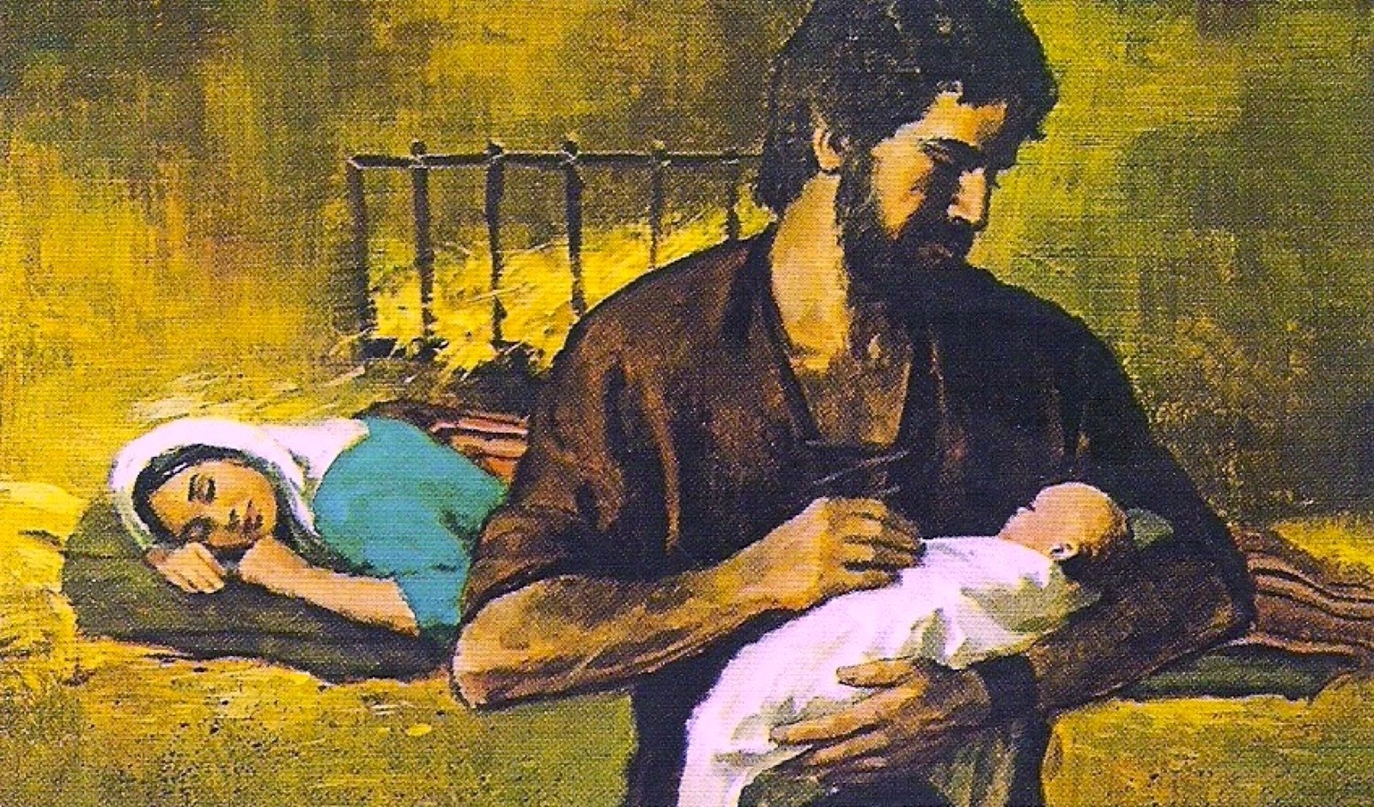
Joseph was just as chosen as Mary

Slide 13

You are chosen

Slide 14
1 Corinthians 12: 12-30
¹² Just as a body, though one, has many parts, but all its many parts form one body, so it is with Christ. ¹³ For we were all baptized by^{[c]} one Spirit so as to form one body—whether Jews or Gentiles, slave or free—and we were all given the one Spirit to drink. ¹⁴ Even so the body is not made up of one part but of many.
¹⁵ Now if the foot should say, “Because I am not a hand, I do not belong to the body,” it would not for that reason stop being part of the body. ¹⁶ And if the ear should say, “Because I am not an eye, I do not belong to the body,” it would not for that reason stop being part of the body. ¹⁷ If the whole body were an eye, where would the sense of hearing be? If the whole body were an ear, where would the sense of smell be? ¹⁸ But in fact God has placed the parts in the body, every one of them, just as he wanted them to be. ¹⁹ If they were all one part, where would the body be? ²⁰ As it is, there are many parts, but one body.
²¹ The eye cannot say to the hand, “I don’t need you!” And the head cannot say to the feet, “I don’t need you!” ²² On the contrary, those parts of the body that seem to be weaker are indispensable, ²³ and the parts that we think are less honourable we treat with special honour. And the parts that are unpresentable are treated with special modesty, ²⁴ while our presentable parts need no special treatment. But God has put the body together, giving greater honour to the parts that lacked it, ²⁵ so that there should be no division in the body, but that its parts should have equal concern for each other. ²⁶ If one part suffers, every part suffers with it; if one part is honoured, every part rejoices with it.
²⁷ Now you are the body of Christ, and each one of you is a part of it. ²⁸ And God has placed in the church first of all apostles, second prophets, third teachers, then miracles, then gifts of healing, of helping, of guidance, and of different kinds of tongues. ²⁹ Are all apostles? Are all prophets? Are all teachers? Do all work miracles? ³⁰ Do all have gifts of healing? Do all speak in tongues^{[d]}? Do all interpret?

Slide 15
Psalm 139
For the director of music. Of David. A psalm.
¹ You have searched me, Lord, and you know me. ² You know when I sit and when I rise; you perceive my thoughts from afar. ³ You discern my going out and my lying down; you are familiar with all my ways. ⁴ Before a word is on my tongue you, Lord, know it completely. ⁵ You hem me in behind and before, and you lay your hand upon me. ⁶ Such knowledge is too wonderful for me, too lofty for me to attain.
⁷ Where can I go from your Spirit? Where can I flee from your presence? ⁸ If I go up to the heavens, you are there; if I make my bed in the depths, you are there. ⁹ If I rise on the wings of the dawn, if I settle on the far side of the sea, ¹⁰ even there your hand will guide me, your right hand will hold me fast. ¹¹ If I say, “Surely the darkness will hide me and the light become night around me,”
¹² even the darkness will not be dark to you; the night will shine like the day, for darkness is as light to you.
¹³ For you created my inmost being; you knit me together in my mother’s womb. ¹⁴ I praise you because I am fearfully and wonderfully made; your works are wonderful, I know that full well. ¹⁵ My frame was not hidden from you when I was made in the secret place, when I was woven together in the depths of the earth. ¹⁶ Your eyes saw my unformed body; all the days ordained for me were written in your book before one of them came to be. ¹⁷ How precious to me are your thoughts,^{[a]} God! How vast is the sum of them!

Slide 16
Psalm 139
¹⁸ Were I to count them, they would outnumber the grains of sand— when I awake, I am still with you.
¹⁹ If only you, God, would slay the wicked! Away from me, you who are bloodthirsty! ²⁰ They speak of you with evil intent; your adversaries misuse your name. ²¹ Do I not hate those who hate you, Lord, and abhor those who are in rebellion against you? ²² I have nothing but hatred for them; I count them my enemies. ²³ Search me, God, and know my heart; test me and know my anxious thoughts. ²⁴ See if there is any offensive way in me, and lead me in the way everlasting.

